Slide 1

Introduction to Machine Learning-CSL 2010
Loan Approval Prediction

Slide 2

Team Members
GOPALA RAM JYANI(B22ME075)
HETARTH JODHA (B22MT021)
PUSHKIN DUGAM (B22ME052)
VINIT THAKUR (B22ES026)
WASIM AKRAM (B22CI048)

Slide 3

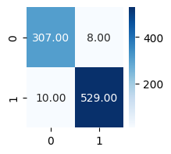
LOGISTIC REGRESSION
Accuracy Score-90.51%
Number of folds-5
Average Cross-Validation Accuracy- 92.18%
Maximum Cross-Validation Accuracy- 94.14%
Test Set Accuracy- 90.52%
K-Fold cross-validation provides an estimate of how well the model is expected to perform on unseen data
The dataset was divided into 5 subsets or folds for cross-validation. This means the model was trained and evaluated five times, each time using a different fold as the test set and the remaining folds for training.
The test set accuracy is slightly lower than the average cross-validation accuracy. This is not uncommon, as cross-validation provides an estimate of how well the model is expected to perform on unseen data, but the test set provides a more direct measure of generalization to completely new and independent data.
Confusion Matrix

Slide 4

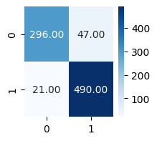
KNN CLASSIFIER
Bootstrapping is a statistical resampling technique used to estimate the sampling distribution of a statistic by repeatedly resampling with replacement from the observed data.
The increasing trend in accuracy with higher values of k suggests that, in this context, a larger number of neighbors is contributing to better generalization. However, this trend might not hold indefinitely, as increasing k too much can lead to oversmoothing and decreased model sensitivity.
The use of stratified bootstrapping helps assess the model's stability and performance across multiple samples.
Accuracy-91.33%
Average Stratified Bootstrapped Accuracy for
k=3: 90.34%
k=4: 90.60%
k=5: 91.30%
k=6: 91.48%
k=7: 91.71%
k=8: 91.77%
k=9: 91.95%
k=10: 92.03%
k=11: 92.30%
k=12: 92.18%
k=13: 92.56%
k=14: 92.33%
k=15: 92.59%
Confusion Matrix

Slide 5

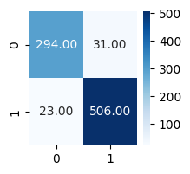
SUPPORT VECTOR CLASSIFIER
The accuracy of 91.68% indicates that the SVM model performs well in terms of overall classification accuracy.
The high precision of 95.25% suggests that when the model predicts a positive instance, it is correct about 95.25% of the time. This is important in scenarios where false positives are costly.
The recall of 91.60% indicates that the model is effective at capturing a high percentage of the actual positive instances. This is important in scenarios where false negatives are costly.
The F1 score of 93.39% provides a balanced measure of precision and recall. It is a useful metric when there is an imbalance between the classes.
Accuracy- 91.68%
Precision- 95.25%
Recall- 91.60%
F1 Score- 93.39%
Confusion Matrix

Slide 6

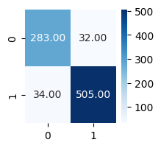
Linear Discriminant Analysis
LDA aims to find a linear combination of features that characterizes or separates two or more classes. It maximizes the distance between the means of different classes while minimizing the spread (variance) within each class.
LDA calculates linear discriminant functions for each class. These functions are linear combinations of the input features that maximize the separation between classes.
Confusion Matrix
Accuracy of LDA model-90.51%

Slide 7

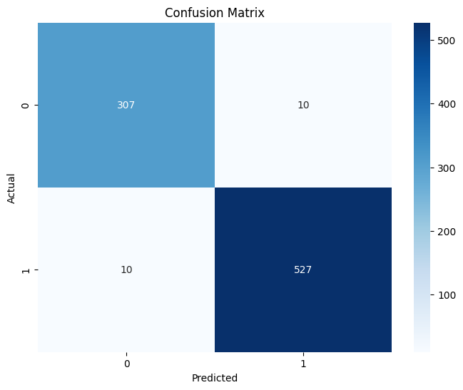
DECISION TREE CLASSIFIER
Accuracy: 96.83
Precision: 96.84
Recall: 96.83
F1 Score: 96.84
The high accuracy, precision, recall, and F1 score collectively suggest that the decision tree classifier performs very well on the given dataset.
The decision tree model is accurate in classifying instances into their respective classes, as indicated by the high accuracy.
The high precision indicates that when the model predicts a positive outcome (for a specific class), it is correct the vast majority of the time. This is valuable in scenarios where false positives are undesirable.
The high recall indicates that the model effectively captures a large percentage of the actual positive instances. This is important in scenarios where false negatives need to be minimized.
The F1 score, being a balance between precision and recall, reinforces the notion that the model achieves a good compromise between making accurate positive predictions and capturing most of the positive instances.

Slide 8

LINEAR REGRESSION
MSE-0.09101206710343021
R2_Score-0.6100749183064854
MSE measures the average squared difference between the predicted values and the actual values. It is calculated by taking the average of the squared differences between predicted and actual values for each data point.
In our case, MSE is 0.091, which is a relatively low value. A lower MSE indicates that, on average, the predictions of your linear regression model are close to the actual values.
R2 Score, also known as the coefficient of determination, measures the proportion of the variance in the dependent variable that is predictable from the independent variables. It ranges from 0 to 1, where 1 indicates a perfect prediction and 0 indicates that the model is no better than predicting the mean of the target variable.
An R2 Score of 0.61 means that approximately 61% of the variance in the dependent variable is explained by the independent variables in your linear regression model.

Slide 9

DECISION TREE REGRESSOR
The results suggest that our Decision Tree Regressor performs well, with a high initial R-squared score and a low initial RMSE. After hyperparameter tuning, there is a slight improvement in performance, as indicated by a lower RMSE and a higher R-squared score.
Cross-validation results reinforce the model's generalization performance, with both average and maximum accuracy scores indicating high consistency and accuracy in predicting unseen data.
Accuracy Score-97.07
Initial Root Mean Squared Error (RMSE): 0.16
Initial R-squared Score: 0.88
After Hyperparameter Tuning:
Root Mean Squared Error (RMSE): 0.15
R-squared Score: 0.90
Custom Accuracy (within 0.5 units): 97.66%
Average Cross-Validation Accuracy: 97.60%
Maximum Cross-Validation Accuracy: 99.12%

Slide 10


ENSEMBLE MODEL-1 (RANDOM FOREST CLASSIFIER)
Accuracy: 98.00%
An accuracy of 98.00% is generally considered very high. It suggests that the Random Forest Classifier is making accurate predictions on the majority of instances in our dataset.
Confusion Matrix

Slide 11


ENSEMBLE MODEL-2 (XGBOOST CLASSIFIER)
XGBoost Classifier Metrics:
Accuracy: 97.89%
Precision: 97.89%
Recall: 97.89%
F1 Score: 97.89%
It appears that the XGBoost Classifier is performing very well across multiple aspects of classification, demonstrating high accuracy, precision, recall, and F1 Score.

